Slide 1
PIR Sensor
IOT - Semester - 9 - Vraj Suratwala
Demo : PIR Sensor

Slide 2
Understanding of PIR Sensor
PIR Sensor, the full name of which is Passive Infrared Sensor. It is a very common electronic component in modern electronic products.
For instance, in smart lighting (where the lights automatically turn on as soon as you enter a room), security alarms (instantly capturing any suspicious movement), and automatic doors, PIR motion sensors all play a crucial role.
The PIR sensor is an electronic component widely used in motion detection. It can sense changes in infrared radiation (that is, heat) from the human body, animals or other heat sources. It is often referred to as an infrared motion sensor, PIR detector or PIR motion sensor.
Because it does not emit any signals by itself but only passively receives and measures infrared energy in the surrounding environment, it is also called a "passive" sensor.

Slide 3
Understading PIR Sensor
Compared with active infrared sensors (which need to emit infrared light and detect reflections to sense objects), PIR motion sensors only need to detect changes in natural heat and do not emit any signals.
This not only makes the PIR sensor more power-efficient, but also reduces false alarms caused by light reflection or environmental changes. In addition, PIR sensors have many other advantages.

Slide 4
Advantages of PIR Sensor
1. PIR sensors can sensitively capture the movement signals of heat sources such as human bodies and animals. It has a low false alarm rate, strong anti-interference ability and can work stably in various environments.
2. The PIR sensor has a simple structure, requires few components and has a low production cost.
3. When movement occurs, the PIR sensor can respond in an extremely short time. This makes it highly suitable for automated scenarios that require real-time detection.
4. The PIR sensor is not affected by external factors such as light and dust, and can operate normally in the dark, strong light or complex environments.

Slide 5
Working of PIR Sensor
To understand PIR sensors’ working principle, we need to first recognize the scientific basis of infrared radiation, that is, all objects above absolute zero will continuously emit infrared rays.
The PIR sensor can work precisely by taking advantage of this natural phenomenon. It determines whether there are people or animals moving within its detection range by sensing changes in infrared radiation in the environment.
Understanding this point well makes it very simple to understand the working principle of the PIR sensor. Its core is a special material with a pyroelectric effect that can sense infrared heat.
The so-called pyroelectric effect refers to the fact that when materials absorb different infrared heat and their temperatures change, they will generate tiny electrical signals.

Slide 6
Working of PIR Sensor
Most PIR motion sensors have two sensing elements placed side by side. When the ambient temperature is stable, the two components receive the same signal, and the output of the PIR sensor remains at a low level.
When a heat source (such as a human body) moves within the sensing area, one component senses the temperature change before the other. In this way, the PIR detection sensor will output a change signal, thereby detecting the movement more accurately.

Slide 7
Working of PIR Sensor
In addition to the core principle, the detection distance and sensing angle of the PIR motion sensor are also very important parameters. The detection distance of common PIR sensors is generally 5 to 12 meters, and the sensing angle is mostly between 90 and 120 degrees.
It still depends on the design of the lens and the model of the module. In practical applications, choosing the appropriate PIR sensor module is also key to achieving precise and stable motion detection. Below, we will introduce the relevant content of the PIR sensor module.
reference : https://pcbasic.com/blog/pir_sensor.html

Slide 8
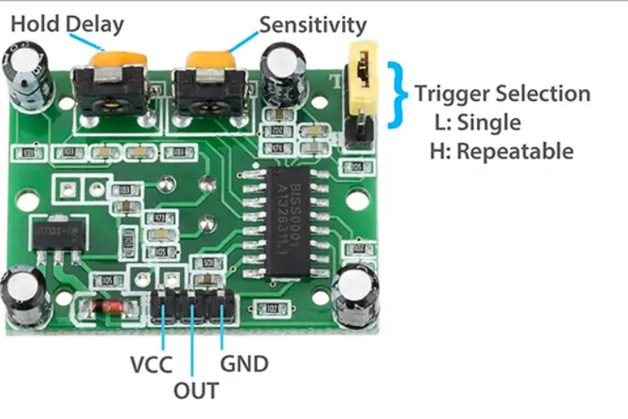
PIR Sensor Circuit

Slide 9
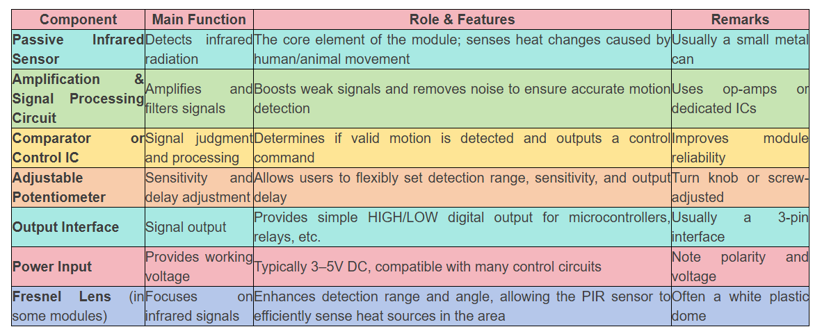
Description of PCB

Slide 10
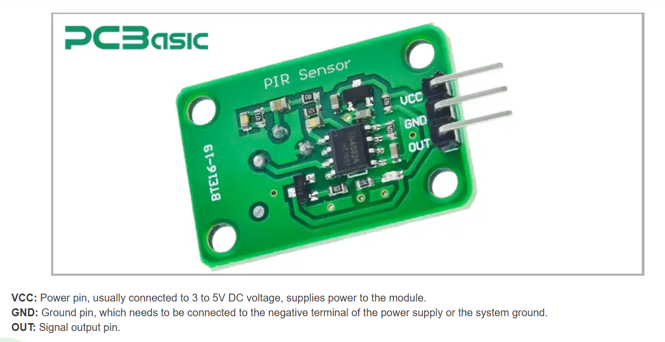
One more try to Understand!

Slide 11
Two Possible Adjustments in PIR Sensor
Most PIR detection sensor modules are equipped with two adjustable knobs (potentiometers) for:
1. Delay adjustment
Set the duration for which the module outputs a high-level signal after detecting motion. It can be freely adjusted from very short pulses to just a few seconds.
2. Sensitivity adjustment
Set the detection distance of the passive infrared sensor. By adjusting this knob, the module can be made to respond more sensitively or less sensitively to movement, thereby adapting to different environmental requirements.
These two adjustment functions enable the PIR motion sensor to adapt to different places and achieve the best detection effect.

Slide 12
Now Let’s Move to Practical Portion and Implementation
Demo 1 : PIR Sensor with Raspberry PI (Simplest Testing Demo) :
Problem Statement : Write an IoT Program which will sense the human from PIR Sensor which data will process by Raspberry Pi and Blink an LED when human will be detected.
Component Required :
Raspberry Pi
LED
Register
Breadboard
PIR Sensor
Breadboard

Slide 13
Let’s do the Coding
Python : for Raspberry Pi
import RPI.GPIO as GPIO
import time
GPIO.setmode(GPIO.BCM)
GPIO.setup(18,IO.IN)
GPIO.setup(24, IO.OUT)
while(True):
myin = GPIO.input(18)
if myin == True :
print(“Motion Detected”)
time.sleep(1)
GPIO.Output(24, True)
time.sleep(0.5)
GPIO.Output(24,False)
time.sleep(0.5)

Slide 14
Complex Problem for PID Sensor
Problems :
P1 : write an IoT Program which sense a human from PIR Sensor and Send data to Raspberry Pi.
where Raspi will process the data and print the status either human is detected or not and send the textual data to Arduino UNO using Serial Coommunication.
where Arduino UNO will process and identify the Textual Data and Blink an External LED. (also try this program with Internal LED).
after performing this program.
also implement the duplex communication from Arduino UNO.

Slide 15
Problems
P2 : Perofrm the same P1 problem but with Vice-Versa MCU’s.
P3 : Send PIR Data to Arduino UNO, then again send to Raspberry PI where data will process and some textual data will send to Cloud.(CLoud can be anyone): Preferred Cloud Platform will be : Thinkspeak.

